Slide 1
South
Jater (Ruohao) Xu
Xinpeng Jiang

Slide 2

Humming Bird’s Migration
From: Canada (North)
To: Panama (South)

Slide 3
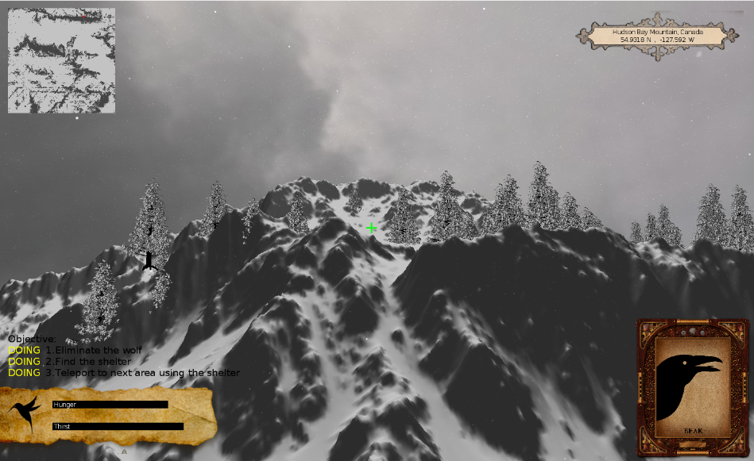
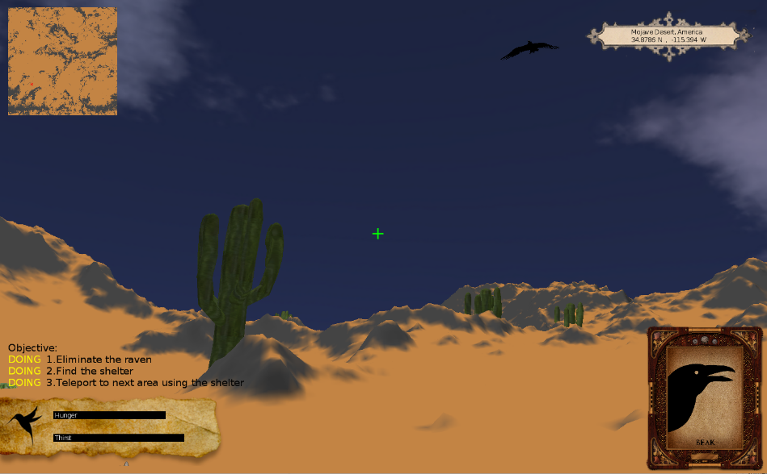
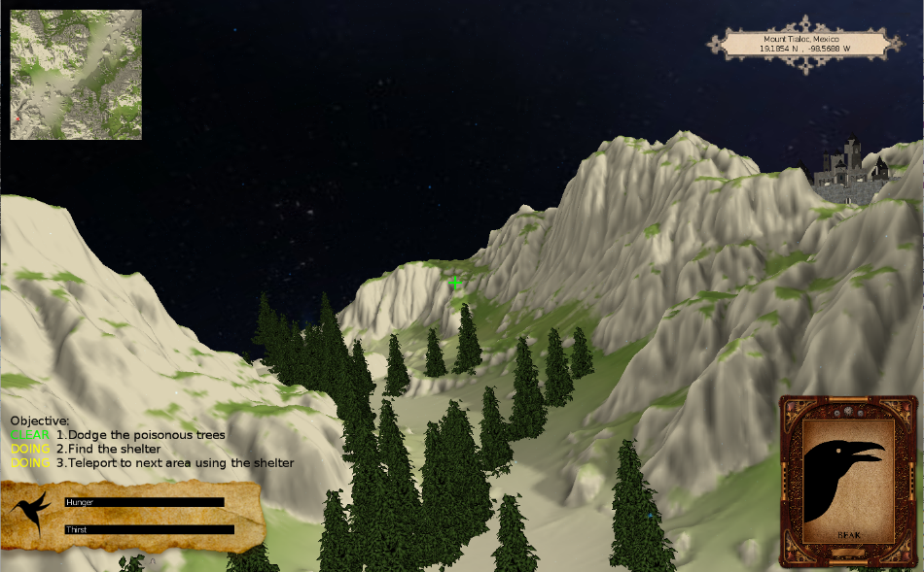
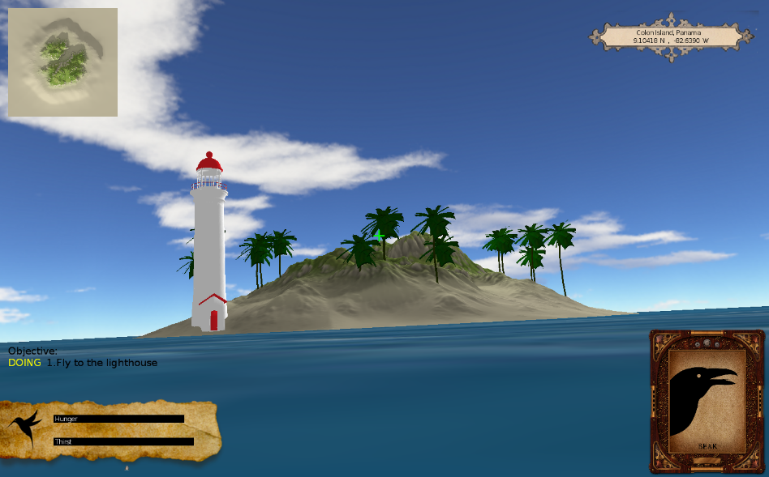
The World
Hudson Bay Mountain, Canada
Time: Dawn, Weather: Snowy
Mojave Desert, America
Time: Sunset, Weather: Cloudy
Mount Tialoc, Mexico
Time: Night, Weather: Clear
Colon Island, Panama
Time: Noon, Weather: Sunny

Slide 4
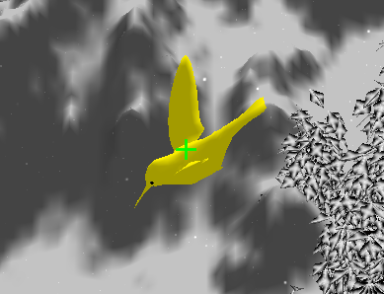
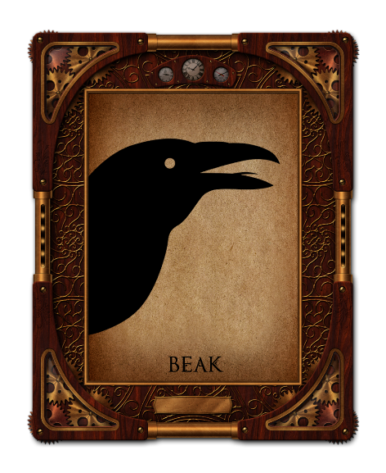


Our Magical Protagonist (3 Types of Weapons)
Under Third Person View
Beak
Melee Attack
Can attack enemies within a certain range
Feather Arrow
Ranged Attack
Burn your feather, shoot them to defend yourself
Hysteria Drone
Remote Attack
Remotely control and detonate the drone to get the upper hand
*Only Available under 1st Person View

Slide 5
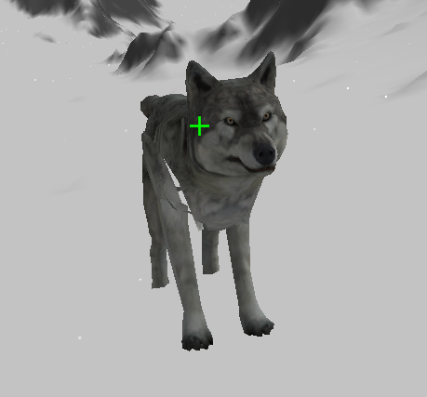
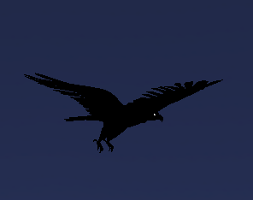
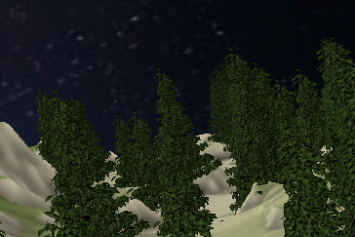
Lions in the way (3 Types of Enemies)
Wolf (Lone Wolf)
Ground Enemy
2000 HP (1000HP for demo version)
Active Area:
Hudson Bay Mountain
Raven (Lone Wolf)
Flying Enemy
1000 HP
Active Area:
Mojave Desert
Needle Trees (Group)
Fixed Enemy
Invincible
Active Area:
Mount Tialoc

Slide 6
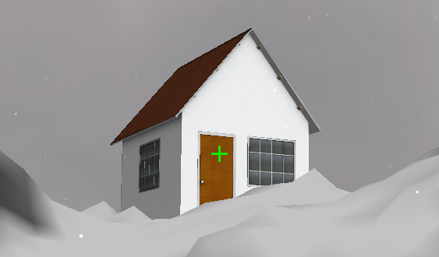
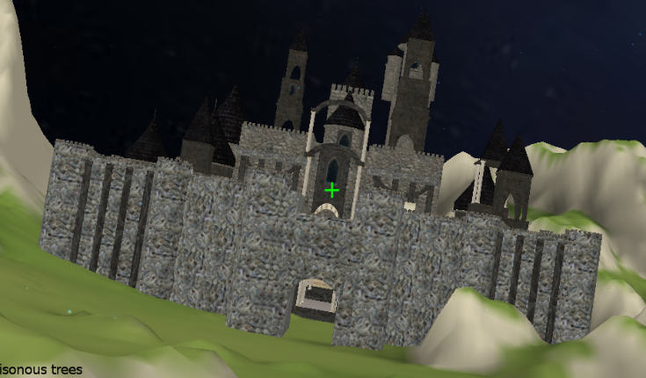
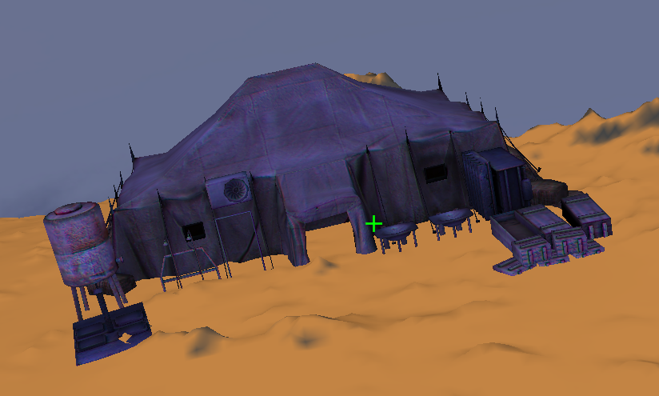
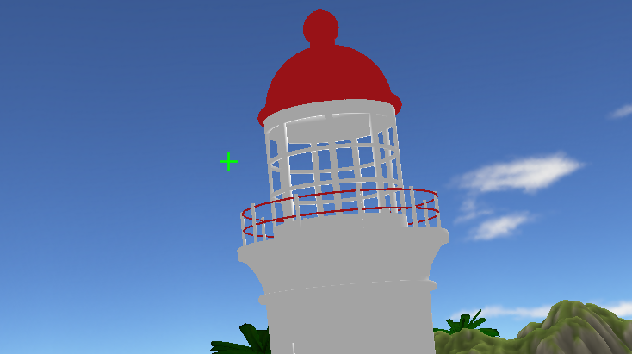
Find a Shelter (Collision Detection)
There will be a shelter for each map, clear the stage and you can teleport to the next map via the shelter

Slide 7
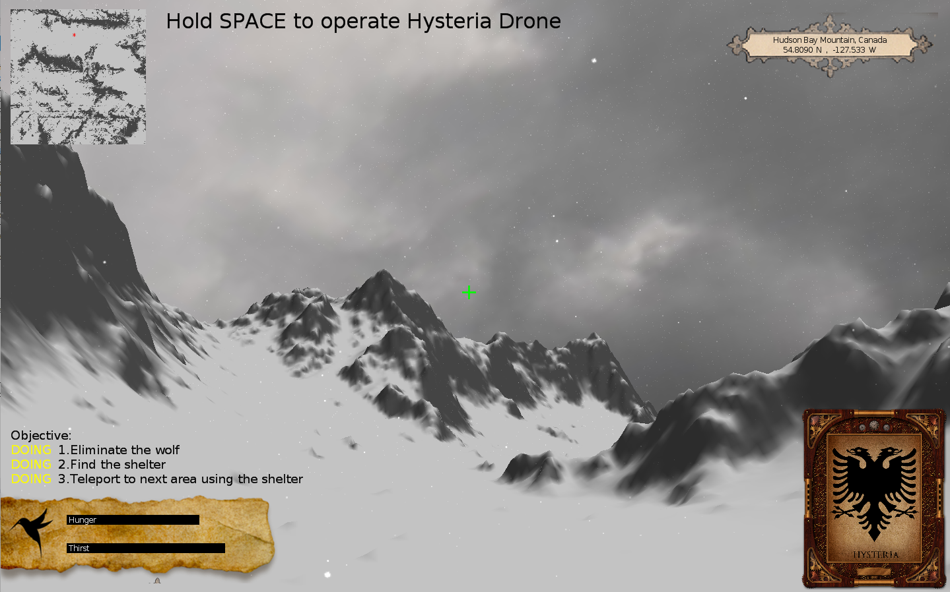
Instruction
Map Indicator
Mini-Map
Crosshair
Wolf: 1000HP
Enemy Info / Warning Message
Mission List
Status Bar
Weapon Panel

Slide 8
Visual Effects
Falling Snow Effect
And
Configuration Menu

Slide 9
Visual Effects
Fire Trace
And
Explosion
Particle Effects

Slide 10
Visual Effects
Spline Effect
Simulates
Fireflies

Slide 11
Visual Effects
Hysteria Drone
Exclusive View
Screen Space Particle Effect

Slide 12
Live Demo!

